Slide 1
How Tox21 Risk Assessments Can Help Bridge Risk Management Uncertainties Facing 21st Century Regulatory Decisions
Steven Bradbury, Ph.D.
Steven P. Bradbury and Associates, LLC
www.spbradbury.com

Slide 2
21st Century Regulatory Decisions Spatial, Temporal and Biological Scales
Ecological & Human Health Risk Assessment
“Overall, the [Tox21] approach results in more rapid, more relevant, and more nimble discovery-screening and prioritization efforts with less reliance on animal testing.”
“What progress is being made to address challenges in implementing the emerging ‘big-data’ toolbox for regulatory decision-making?”
Implementation depends on:
Transparency and consistency leading to trust in decision-making
Nature of the regulatory decisions

Slide 3
Prioritization and Screening “Back to the Future”
The technology may be “new”, but the logic for focusing
risk-based regulatory schedules is not.
OECD Principles for QSAR Validation: Transparency & Utility for a Specified Application
Predicted endpoint is defined.
Mechanistic interpretation associated with predictions, if possible.
Defined chemical domain of applicability for the model.
Appropriate measures of goodness of fit, robustness, ability to predict.
An unambiguous algorithm.

Slide 4
Pesticide Discovery to Registration
Goal: Sufficient, Targeted, Credible Information to Support Regulatory Decisions that Protect
Human Health and the Environment
Identify what specific data, for which pesticides, exposure profiles and species potentially at risk to formulate risk-based regulatory decisions consistent with the statutory framework of FIFRA, FFDCA, FQPA and the ESA
Common ‘tools’ needed for human health and ecological assessments – but the status of the data and data sources vary
‘Big data’ challenges in development and application in risk assessments, as well as, potential data compensation and data privacy protection

Slide 5
21st Century Pesticide Regulatory Decisions Spatial, Temporal and Biological Scales
Ecological & Human Health Risk Assessment
Targeting Pesticide Risk Management in Space and Time
Inter- and Intra-Species Extrapolation and Endpoint Uncertainties
Private and Public Pesticide Applicability Domains

Slide 6
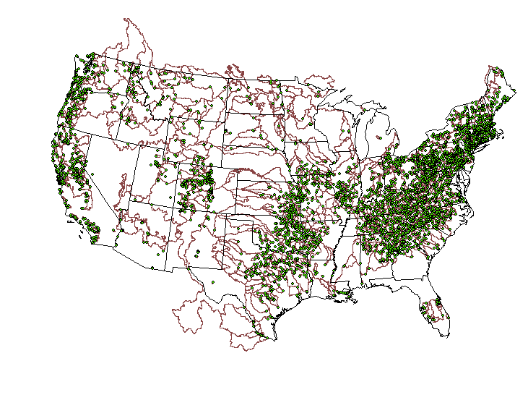
Watersheds with Drinking Water Intakes
(EPA, 2012)

Slide 7
Advancing Ecological Risk Assessments for Pesticides: Assessing Risks to Endangered and Threatened Species from Pesticides (NRC, 2013)
A Common Approach
USEPA Risk Assessment Framework
Exposure
Modeling and Monitoring
Spatial/temporal domains: species range/habitat and pesticide use patterns
Pesticide mode of action and species life history
Geospatial Data and Habitat Delineation – integration of data layers
Effects
Sub-lethal effects: link to survival/reproduction
Species extrapolation
Population models
Mixtures
Value of single pesticide assessment
Likelihood of dose-addition or synergism
Risk Characterization and Uncertainty
Move from deterministic to probabilistic risk characterization
http://www.nap.edu/catalog.php?record_id=18344 http://www.epa.gov/espp/2013/interagency.pdf

Slide 8

Science & Decisions (NRC, 2009)
The committee encourages EPA to focus greater attention on design in the formative stages of risk assessment, specifically on planning and scoping and problem formulation, as articulated in EPA guidance for ecologic and cumulative risk assessment (EPA 1998, 2003).

Slide 9
Problem Formulation
Integrate Available Information
As Necessary: Acquire Data, Iterate Process, Monitor Results
Source and Exposure Characteristics
Ecosystem Potentially at Risk
Ecological Effects
Planning (Risk Assessor/ Risk Manager Dialogue)
Assessment Endpoints
Conceptual Model
Analysis Plan
Analysis

Slide 10
Ecological Risk Assessment
Planning (Risk Assessor/ Risk Manager Dialogue)
Problem Formulation
As Necessary: Acquire Data, Iterate Process, Monitor Results
Analysis
Characterization of Exposure
Characterization of Ecological Effects
Risk Characterization
Communicating Results to the Risk Manager
Risk Management

Slide 11
Tiered Assessment Process Assessment Uncertainties and Risk Management Decisions
Low spatial, temporal, resolution
In vitro data
Species resolution?
Multiple lead compounds?
Deterministic
Ecological Risk Assessment
PROBLEM FORMULATION
ANALYSIS
Characterization
Characterization
of
of
Exposure
Ecological
Effects
Ecological Risk Assessment
RISK CHARACTERIZATION
PROBLEM FORMULATION
ANALYSIS
Characterization
Characterization
Site-specific resolution
Targeted In vivo studies
Compound/Species- specific endpoints
Population responses
Probabilistic
of
of
Exposure
Ecological
Effects
Ecological Risk Assessment
RISK CHARACTERIZATION
PROBLEM FORMULATION
ANALYSIS
Characterization
Characterization
of
of
Exposure
Ecological
Effects
RISK CHARACTERIZATION

Slide 12

Toxicity Testing in 21st Century: A Vision and Strategy (NRC, 2007)
Population and Exposure Data
Risk Contexts
Chemical Characterization
Toxicity Testing
Toxicity Pathways
Targeted Testing
Dose-Response and Extrapolation Modeling

Slide 13
Toxicity Pathways
Chemical Extrapolation
Chemical
Exposure
Uptake-Delivery to Target Tissues
Species Extrapolation
Perturbation
Cellular Response Pathway
“Normal”
Biological
Function
Biologic Inputs
Early Cellular
Changes
Adaptive
Responses
Cell Injury, Inability to Regulate
Adverse
Outcomes
(e.g., Mortality,
Reproductive
Impairment)
Species Extrapolation
Molecular
Initiating Event
Perturbed Cellular
Response Pathway
Adverse Outcome
Relevant to
Risk Assessment
Chemical & Non- Chemical Stressors
Modified From NRC 2007

Slide 14
Adverse Outcome Pathway
In vivo studies
In vitro studies
Structure Activity Relationships
Chemicals
Pharmaco- kinetics
Molecular Target
Cellular Response
Tissue Organ
Individual
Population
Communities within Landscapes
Toxicity Pathways
Monitoring
Molecular
Initiating Event
Key Events or Predictive
Relationships Spanning
Levels of Biological
Organization
Adverse Outcome
Relevant to
Risk Assessment
Greater Toxicological Understanding
Greater Risk Relevance

Slide 15


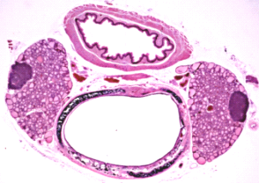


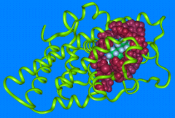
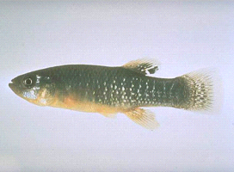

Spatial, Temporal and Biological Scales
Integration of Scales: Source to Outcome
Source
Organism Exposure
Cellular Effects
Population
Environmental Exposure
Molecular Initiating Event
Individual
Community
Toxicity Pathway
Mode of Action
Adverse Outcome Pathway
Source to Outcome Pathway

Slide 16
Building Capacity for Explicit Ecological Risk Assessments
OUTCOME:
Efficient-effective
site-specific risk
assessments
Habitat/Biota Exposure
Models
Habitat-Species Response Models
Chemical, Species
Response Models
Population
Models
Spatial Models
Habitat/Biota Distribution
Data Layers
Demographic
Data
Chemical,
Species
Dose-Response
Data
Species
Molecular
Biochemical
Physiology
Data
Life History
Data
Chemical
Data Layers
Adapted from EPA (2005)

Slide 17
International
US Government
Supply Chains
States
Counties
Source to Outcome
Tox21- AOPs
Risk Assessments and Management Decisions
Adapted from: Jackson et al, 2010. Biodiversity and agricultural sustainability: from assessment to adaptive management. Current Opinions in Environmental Sustainability. 2:80-87.

Slide 18

Business Case: Pesticide Discovery to Registration
Vision
Timely, targeted and credible information to inform regulatory decisions – certainty for regulated community and public
TIME & COST
BENEFIT
Goal
Implementation
Perturbation or adverse effect? Weight of evidence and uncertainty
Pooling applicability domains
PRIA
Risk-based regulatory decisions
Data transparency
Public participation

